Slide 1
Test CYcles

Slide 2
What is test cycles
A test cycle is a focused set of test cases that are grouped to achieve specific testing goals. Test cycles are larger and more broad in scope than test cases, and they can be assigned to specific testers and test environments. Examples of test cycles include regression tests, build-verification tests, end-to-end tests, etc.
The Testing Cycles area lists all testing cycles of the current project. It is the central part of the Manual Execution Planning page and displays on both the Test Selection and on the Test Assignment view. The testing cycles are ordered chronologically.

Slide 3
Components of test cycles
The name of the testing cycle.
The start and end dates.
A burn-down chart that visualizes the testing progress
The capacity that is left. This value is calculated as follows: The sum of planned time of the assigned tests minus the capacity sum of the manual testers. This value displays both for the testing cycle and each individual tester.
The number of assigned tests and the completed tests for both the testing cycle and each individual tester. Move the mouse over these numbers to get detailed information.
The manual testers that are assigned to each testing cycle. Click on the number of the assigned testers to expand or collapse the detailed information.

Slide 4
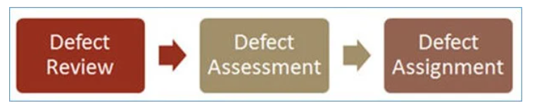
What is defect /bug triage
Defect triage is a process where each bug is prioritized based on its severity, frequency, risk, etc. Triage term is used in the Software testing / QA to define the severity and priority of new defects.
Why do we need to have ‘Defect Triage’?
The goal of Bug Triage is to evaluate, prioritize and assign the resolution of defects. The team needs to validate severities of the defect, make changes as per need, finalize resolution of the defects, and assign resources. Mainly used in agile project management.

Slide 5
Test reports
Test reporting is a process in software testing that involves gathering, analyzing, and presenting essential test results and statistics to stakeholders. Additionally, a Test Report is a detailed document that contains a summary of the test, the process involved and the final test results.
In simple terms, A Test Report is a summary of all the tests that were done, what was intended to be achieved with them, and what were the testing results once the tests were complete. It aims to summarize the results of the entire testing process formally and shares a comprehensive view of the testing status overall.

Slide 6

Test summary report

Slide 7
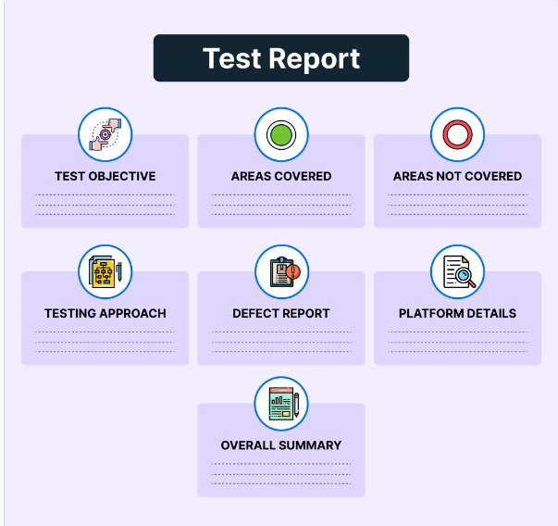
Components of test reports

Slide 8
Importance of test reporting
Test reporting is crucial for software development from an ROI perspective. It helps:
Maintain Cost-effectiveness
Ensure release readiness
Improve User Churn Rate
Better Visibility and Control

Slide 9
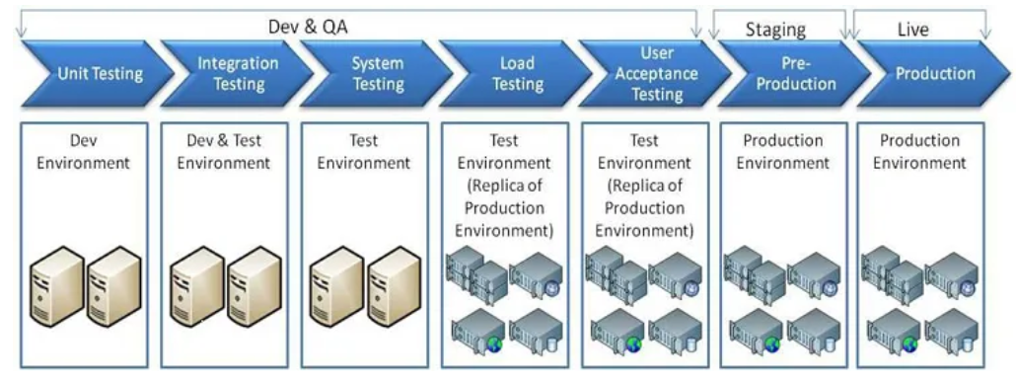
Different environment in software development
Development environment
Testing environment
Staging environment
Production environment

Slide 10
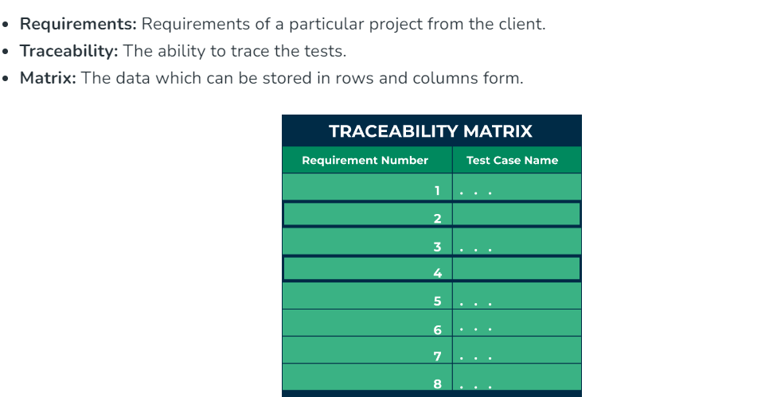
Requirement traceability matrix
RTM stands for Requirement Traceability matrix. RTM maps all the requirements with the test cases. By using this document one can verify test cases cover all functionality of the application as per the requirements of the customer.

Slide 11
Components of rtm
The following are the parameters to be included in RTM:
Requirement ID: The requirement ID is assigned to every requirement of the project.
Requirement description: for every requirement a detailed description is given in the SRS (System/Software Requirement Specification) document.
Requirement Type: understand the type of requirements i.e., banking, telecom, healthcare, traveling, e-commerce, education, etc.
Test cases ID: the testing team designs test cases. Test cases are also assigned with some ID.

